Slide 1

Better Neighborhood in Toronto
Applied data science project

Slide 2
Introduction
Purpose of the Project.
to assist individuals who plan to migrate, settle and or visit Toronto.
analyse and explore its Toronto neighborhood.
Thus, with its availability and application, individuals can make informed, efficient and data driven decision when choosing best neighborhood to visit in Scarborough, Toronto.

Slide 3
Background Information
Globalization has increased net incoming migration especially in countries of the North.
Vast number of people migrate to various places, i.e. states of Canada in this scenario.
This has triggered a need for information of where these individuals are heading to.
This information could be about, job opportunities, vacation spots, or even best neighborhoods for settlement.
With this need of info, arise a need for data, analytics, and science.
This project then, as already stated, is for such individuals who are on the quest for better neighborhoods.
This Project aims to create comparative analysis between neighborhoods. Foursquare API will be employed to carry out such analytics.
The final reporting will include, housing price and school based on ratings, crime rates, spatial analytics i.e. connectivity, weather, management for emergency, water resources and recreational facilities.

Slide 4
Methods and Materials
Foursquare API: Four-square API as its prime data gathering source as it has a database of millions of places
Clustering: To compare the similarities of two cities
Folium: Python visualization library would be used to visualize the neighborhoods cluster distribution of using interactive leaflet map.
Scikit Learn: For importing k-means clustering.
JSON: Library to handle JSON files.
XML: To separate data from presentation and XML stores data in plain text format.
Geocoder: To retrieve Location Data. Beautiful Soup and Requests: To scrap and library to handle http requests. Matplotlib: Python Plotting Module.

Slide 5
Data Description:
Data for this project was retrieved from List of postal codes of Canada: M i.e. Toronto.
Dataset consisting of latitude and longitude, zip codes.
The data retrieved contains info of venues within a specified distance of the longitude and latitude of the postcodes.
The information obtained per venue as follows:
Neighborhood,
Neighborhood Latitude,
Neighborhood Longitude,
Venues, Latitude, Longitude, and Category
Name of the venue e.g. the name of a store or restaurant

Slide 6
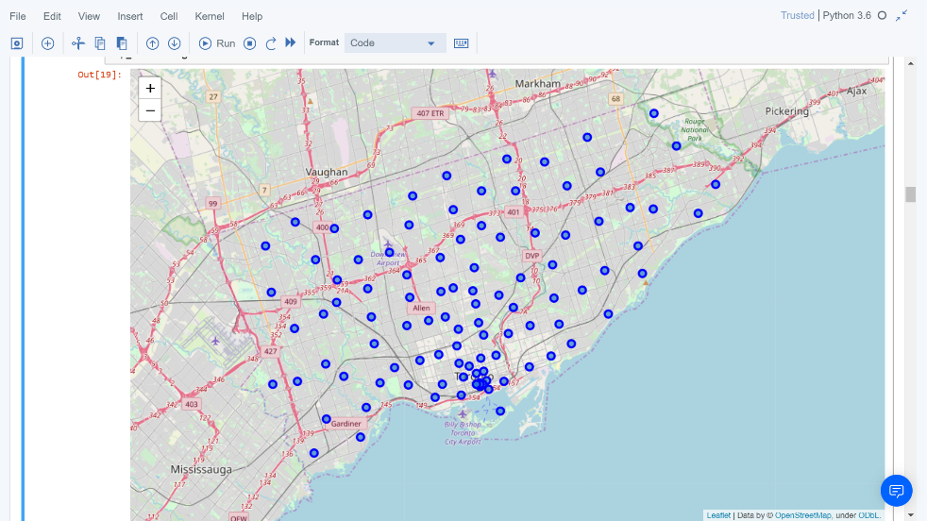
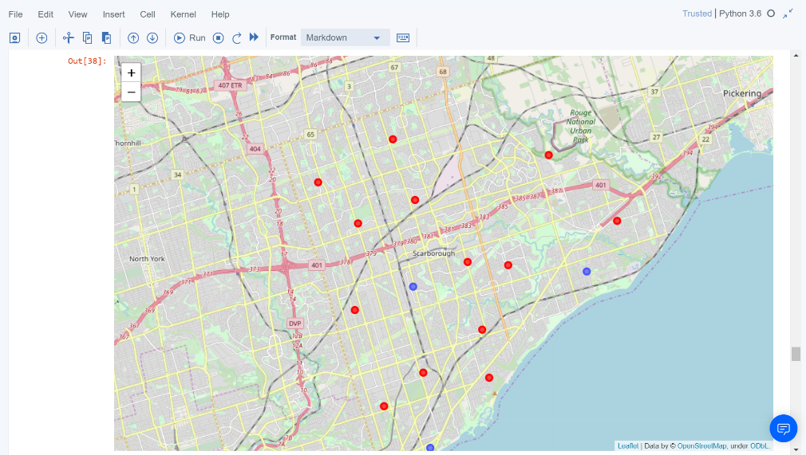
Scarborough map before and after clustering

Slide 7
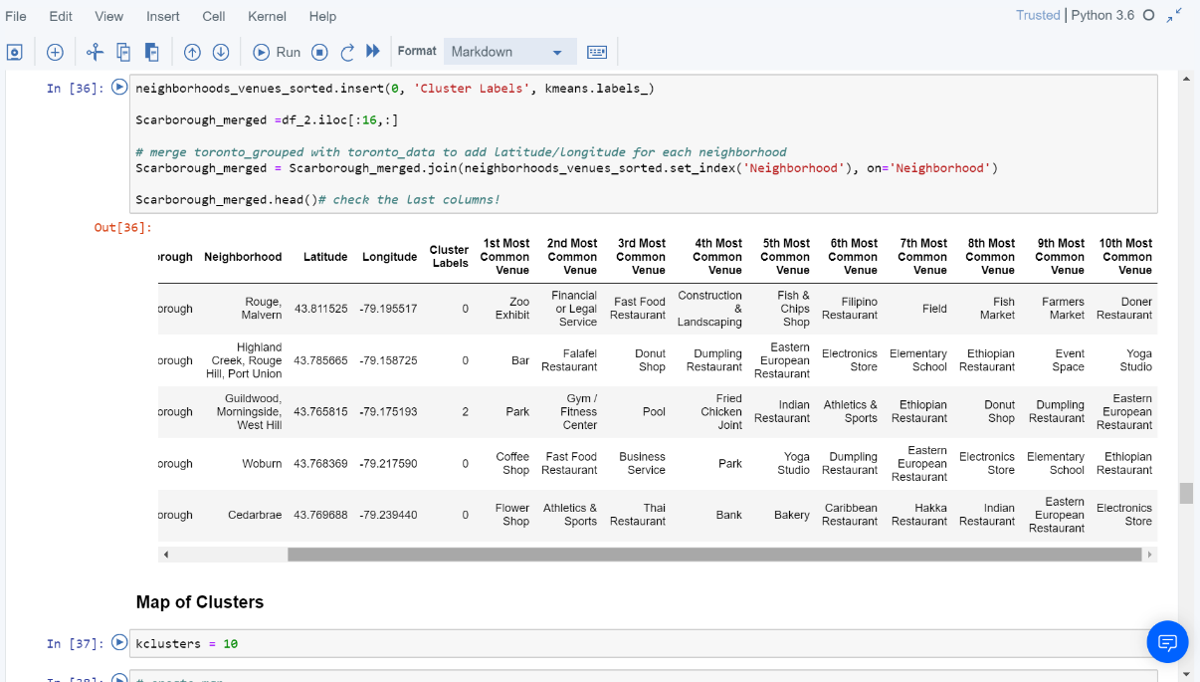
K- means Cluster

Slide 8
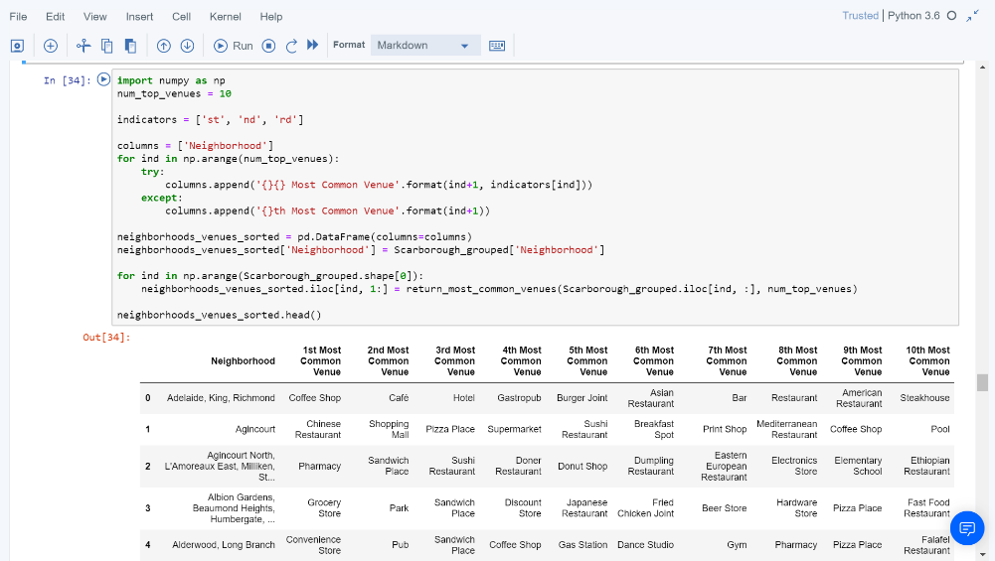
Common places

Slide 9
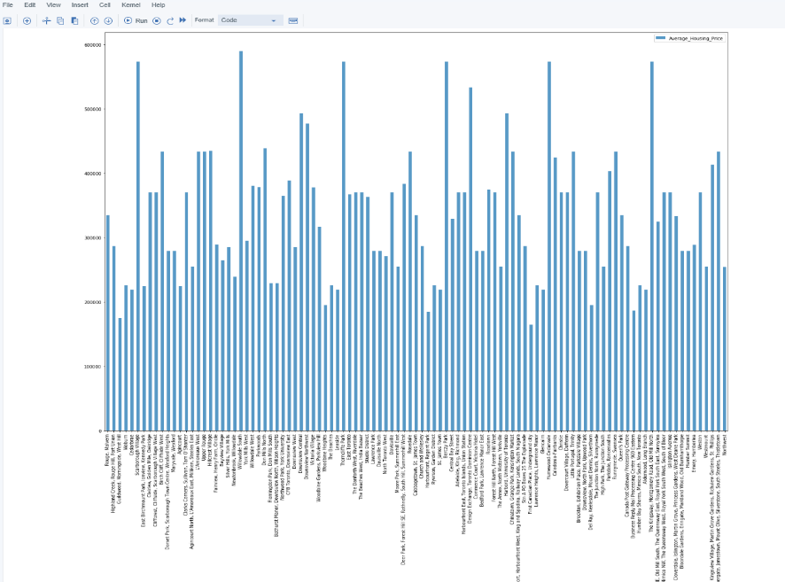
Housing Prices

Slide 10
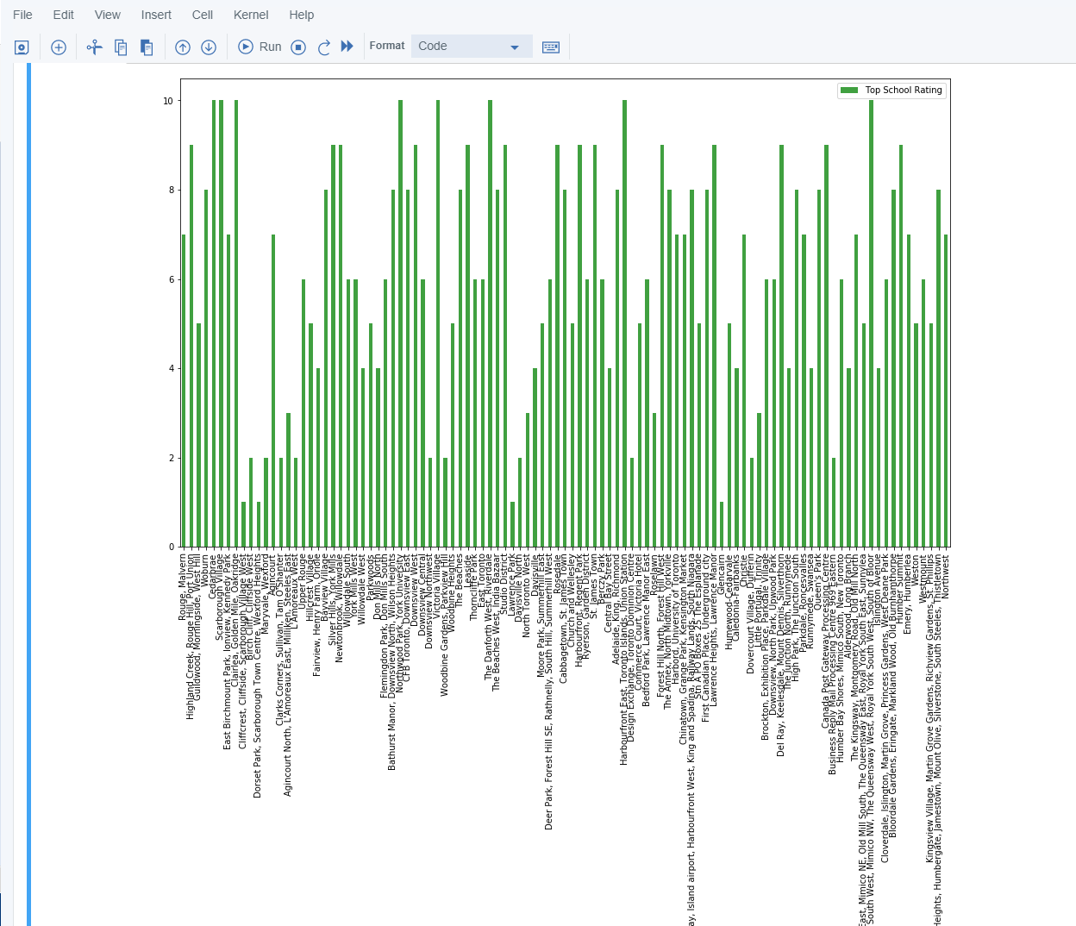
Schools rating

Slide 11
Discussion and conclusion
Different categories of venues were explored.
Initially, were a sum of 103 unique postal codes has been observed for 10 diffrent Borough.
Then the result above were attained through spliting the data into longitude and latitude of the neighborhood.
Each neighborhood was analysed and led to one-hot encoding.
After one hot encoding and venue exploration, the k-means algorithm for k=5 was applied.

